Slide 1


Face Authentication System
Presented By:
Vijay Kumar (2106059)
Mayank Kumar (2106068)
Vineet Raj (2106019)
Rupesh (2106005)
Under the Guidance of :
Dr. Kakali Chatterjee

Slide 2
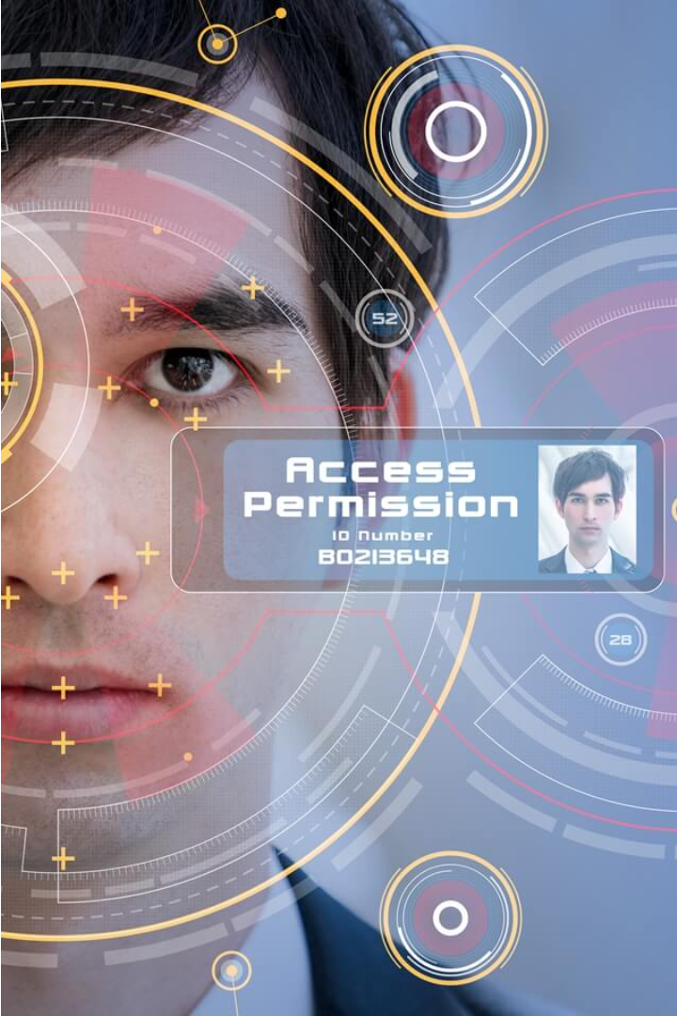
Introduction to Project: Face Authentication System
This presentation will explore the development of a cutting-edge face authentication system, designed to enhance network security through the power of computer vision and machine learning. We'll delve into the project's objectives, literature review, and the technical implementation using Python, Flask, OpenCV, and SQLite.

Slide 3
Literature Review: Existing Approaches and Limitations
Biometric Authentication
Password-Based Authentication
Traditional biometric approaches like fingerprint and iris scanning have limited accessibility and are susceptible to spoofing attacks.
Password-based systems are vulnerable to theft, guessing, and phishing, highlighting the need for more secure alternatives.
Multi-Factor Authentication
Facial Recognition Limitations
While MFA adds an extra layer of security, it can be cumbersome for users and does not fully address the weaknesses of individual factors.
Existing facial recognition systems often struggle with accuracy, especially for diverse user demographics, and raise privacy concerns.

Slide 4
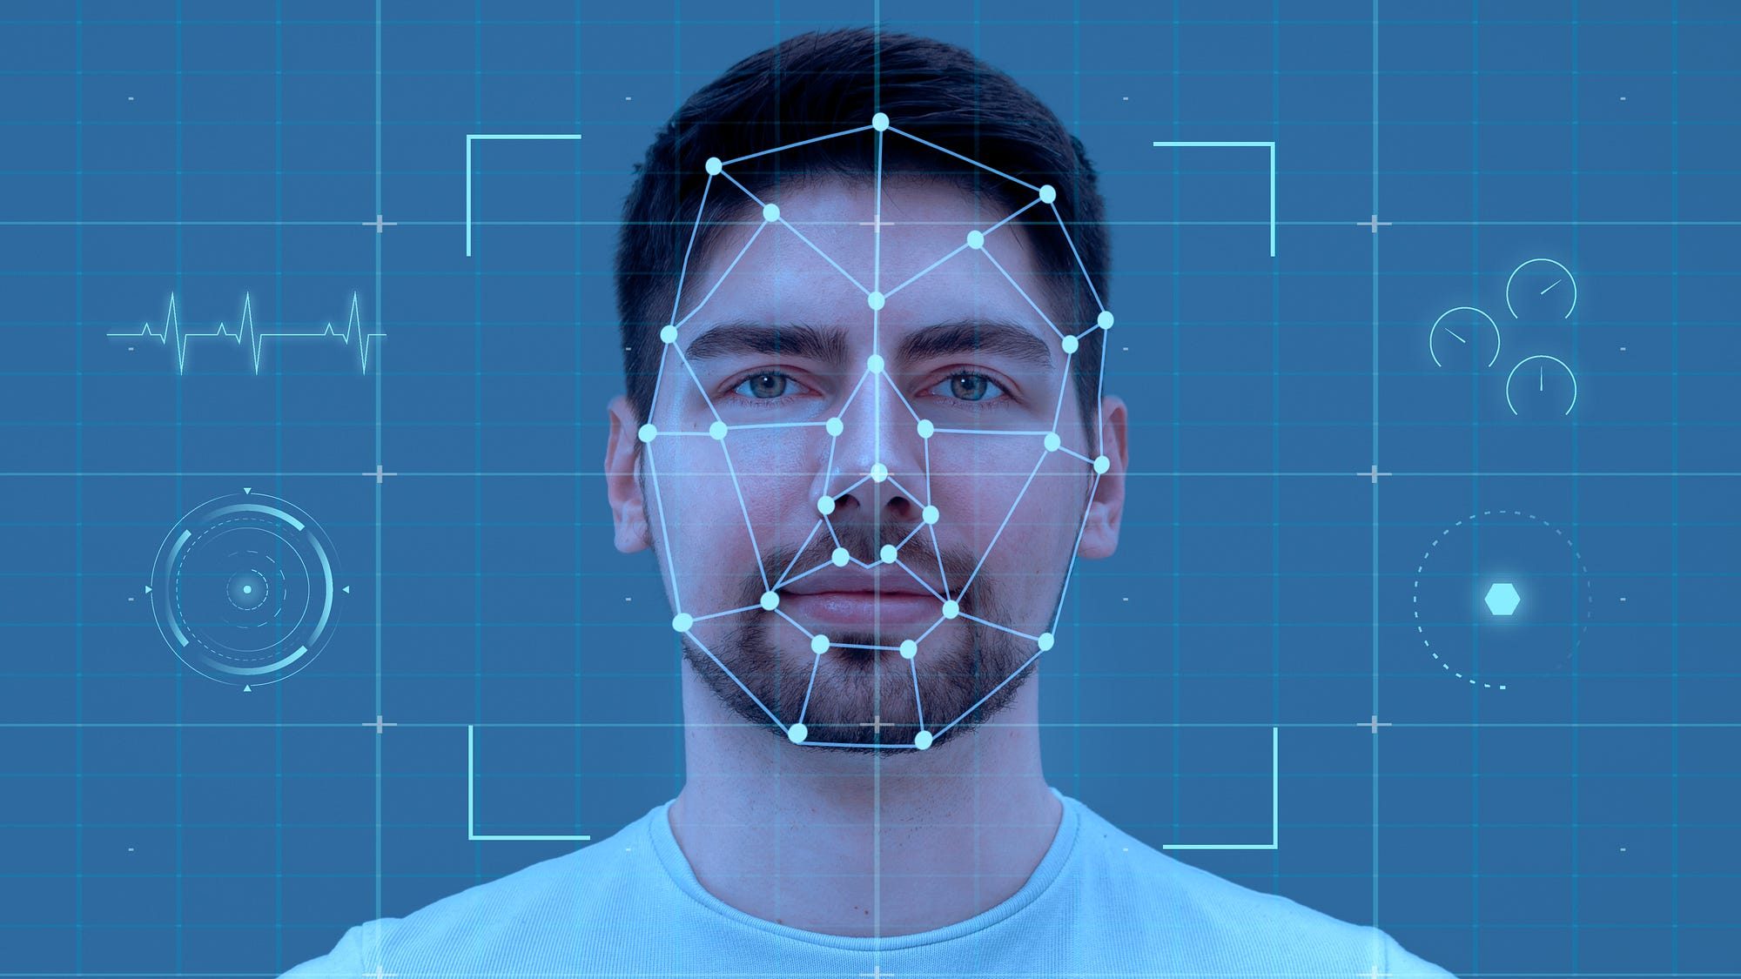
Objective: Develop a Secure Face Authentication System
Create a robust face detection and recognition system using advanced computer vision techniques like Convolutional Neural Networks (CNNs) and Haar Cascade Classifiers.
Integrate the face authentication system with a secure user authorization and access control framework to ensure only verified users can access sensitive resources.
Leverage the power of SQLite database to securely store and manage user facial biometric data, providing fast and efficient retrieval during the authentication process.

Slide 5




Technology Stack: Python, Flask, OpenCV, SQLite, JavaScript
Python
Flask
OpenCV
SQLite
The powerful, versatile programming language used to develop the core functionality of the face authentication system.
The lightweight, flexible Python web framework that powers the server-side application and API.
The open-source computer vision library used for real-time face detection, recognition, and image processing.
The lightweight, serverless database used to store user profiles, authentication credentials, and face recognition data.

Slide 6

Face Detection and Recognition Algorithms
Facial Detection
1
Utilizes computer vision techniques like Haar Cascade Classifiers to locate and identify faces within an image frame.
2
Facial Feature Extraction
Extracts unique facial landmarks and features such as eyes, nose, mouth, and facial contours for recognition.
Facial Recognition
3
Compares extracted facial features against a database of enrolled user profiles to authenticate the user's identity.

Slide 7
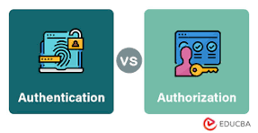
User Authentication and Authorization
The face authentication system employs robust user authentication and authorization mechanisms to ensure secure access to sensitive resources. Users are required to undergo facial recognition to log in, providing an additional layer of security beyond traditional password-based authentication.
Once authenticated, the system grants users access to authorized features and data based on their assigned roles and permissions. This fine-grained access control helps to protect sensitive information and prevent unauthorized actions, strengthening the overall security posture of the application.

Slide 8
Database Integration and Management
Secure Data Storage
Efficient Database Design
Database Backup and Restoration
Scalable Database Infrastructure
The system will utilize a SQLite database to securely store user authentication data, including encrypted face templates and login credentials. Data encryption and access controls will ensure the privacy and integrity of sensitive information.
The database schema will be optimized for fast retrieval and management of user profiles, ensuring smooth and responsive authentication processes. Indexing and normalization techniques will be employed to enhance query performance.
Comprehensive backup and recovery strategies will be implemented to safeguard the system's data. Periodic database backups will be stored securely, and restoration procedures will be in place to quickly recover from potential data loss or system failures.
The database solution will be designed to handle increasing user loads and growing data requirements. Scalability considerations will be taken into account, such as the use of partitioning, replication, or sharding techniques, to ensure the system's long-term viability.

Slide 9
Implementation Challenges and Considerations
1
Technical Complexities
2
Privacy and Security Concerns
Integrating facial recognition algorithms, database management, and user authentication into a cohesive system poses technical hurdles that require careful planning and expert implementation.
Safeguarding user data and ensuring the system's resistance to cyber attacks are paramount to maintaining trust and compliance with data protection regulations.
3
User Adoption and Acceptance
4
Scalability and Performance
Designing an intuitive and user-friendly interface is crucial to encourage widespread adoption and mitigate resistance to the new authentication method.
The system must be capable of handling increasing user volumes and maintaining reliable performance to provide a seamless experience, even under heavy load.

Slide 10
Outcome and Impact on Network Security
The face authentication system developed in this project can significantly enhance network security by providing a robust and reliable user verification method. Leveraging the power of facial recognition technology, this system can effectively replace traditional password-based authentication, mitigating the risks of password theft and unauthorized access.
By integrating the face authentication system with existing network infrastructure, organizations can enjoy improved network security and better protect their valuable data and resources from cyber threats and malicious actors.

Slide 11
References
https://www.kaspersky.com/resourcecenter/definitions/what-is-facial-recognition./
https://www.geeksforgeeks.org/face-recognition-usingartificial-intelligence/
https://www.geeksforgeeks.org/opencv-python-programface-detection/
https://medium.com/@draj0718/opencv-face-detectiondeployment-in-flask-web-framework-1a9b9772d9fd/

